Slide 1
My EZ Shopper
For ACS 560 at Indiana-Purdue University, Fort Wayne
Andy Garcia | Matt Parker
garciaac01 | mcparker76

Slide 2
Non-Functional Requirement—Operating Systems
6. Client application will use Java programming language on Android Operating System.

Slide 3
Non-Functional Requirement—Operating Systems
7. Server application will use JavaScript programming language with node.js on Linux Operating System.
Node.js is a cross-platform runtime environment for server-side applications using JavaScript
Our implementation includes:
Main server file (server.js)
models (user, deal)
node_modules
body-parser for parsing JSON
cron for scheduling tasks
express for handling HTTP methods
moment for formatting date objects
mongoose for handling mongodb database access
morgan for logging HTTP requests

Slide 4
Non-Functional Requirement—Server Datasource
8. Server application will use mongodb as datasource.
MongoDB is an open-source, no SQL, document-oriented database
A collection is a group of MongoDB documents (equivalent to a RDBMS table)
Documents within a collection can have different fields represented as key-value pairs
Consequently, JSON is an effective source of input and output

Slide 5
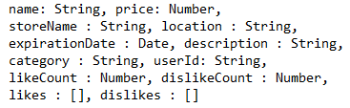

Non-Functional Requirement—Server Datasource
8. Server application will use mongodb as datasource.
Schema for Deal collection:
Schema for User collection:

Slide 6
Functional Requirement—Shopping List
1. Users will be able to manage their shopping list. (Managing their shopping list will include adding, editing, and removing items.)
1A. Users will be able to add items to their shopping list. (Being able to add an item to the list is an essential feature.)
1B. Users will be able to edit items in their shopping list. (The ability to edit an item is needed in case user enters inaccurate information.)
1C. Users will be able to remove items from their shopping list. (The ability to remove an item is an essential feature.)

Slide 7
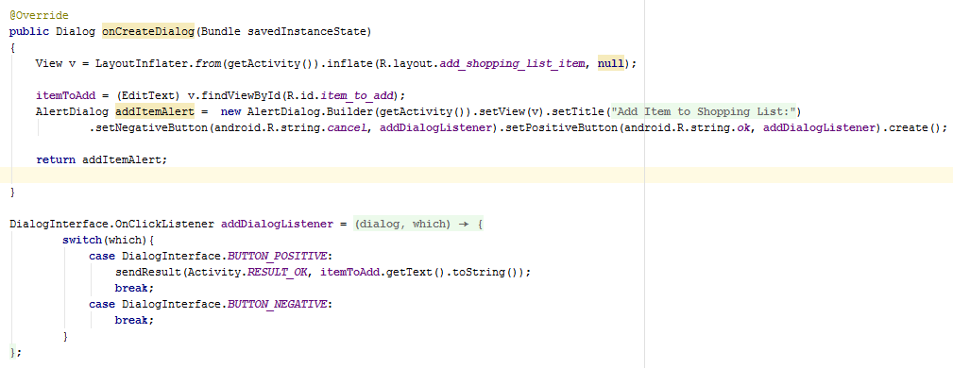
Shopping List, Add—Client Side Implementation

Slide 8
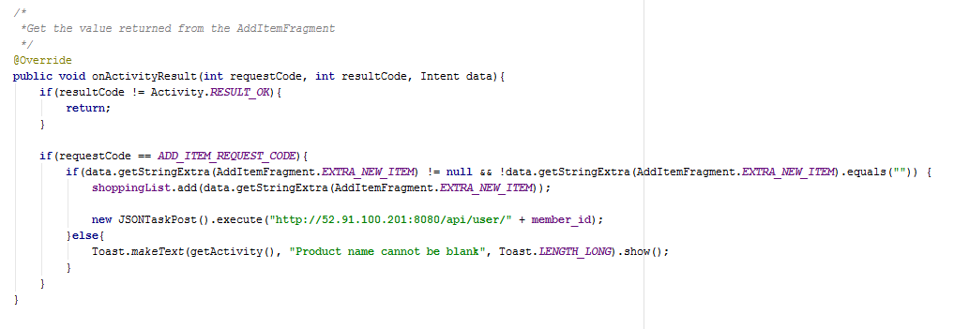
Shopping List, Add—Client Side Implementation
Dialog fragment returns to the class that called it.
“requestCode” is used by the Class to identify who is “reporting in”
After a check is made to make sure the product name is not empty, we post the new contents of shoppingList to the database

Slide 9
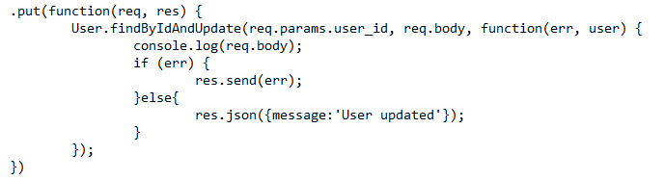
Shopping List, Add—Server Side Implementation
express module parses route to those that end in /user/:user_id
req is JSON request object containing updated information
req also includes parameter with user id
Uses the mongoose method findByIdAndUpdate
Returns error http response or returns http ok response

Slide 10

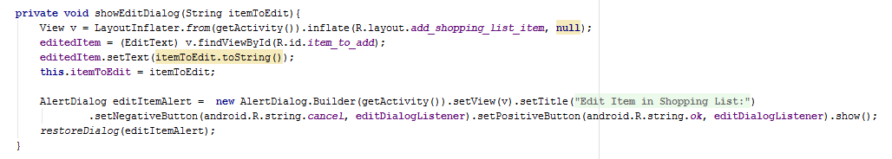
Shopping List, Edit—Client Side Implementation
Similar implementation to Add
A String with the product text is sent, and this is set to the value of the editedItem widget
restoreDialog function is used to handle rotation

Slide 11
Shopping List, Edit—Server Side Implementation
Same functionality as Adding to list
express module parses route to those that end in /user/:user_id
req is JSON request object containing updated information
req also includes parameter with user id
Uses the mongoose method findByIdAndUpdate
Returns error http response or returns http ok response

Slide 12
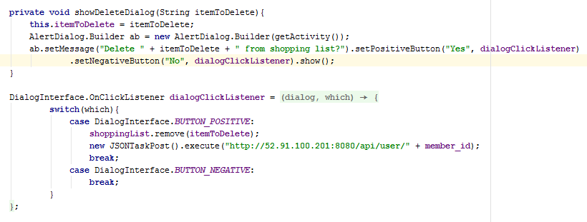
Shopping List, Remove—Client Side Implementation
Avoided code duplication by re-using JSONTaskPost, like Add and Edit use.
The deleted item is removed from the shoppingList ArrayList and posted to the database
RecyclerView UI is refreshed each time we post to the database, keeping the user’s view up to date

Slide 13
Shopping List, Remove—Server Side Implementation
Same functionality as Adding to list and Editing list
express module parses route to those that end in /user/:user_id
req is JSON request object containing updated information
req also includes parameter with user id
Uses the mongoose method findByIdAndUpdate
Returns error http response or returns http ok response

Slide 14
Functional Requirement—API Deals
2. Users will be able to search for sale prices at supported stores for an item in their shopping list. (This will allow users to find prices for an item of interest.)

Slide 15
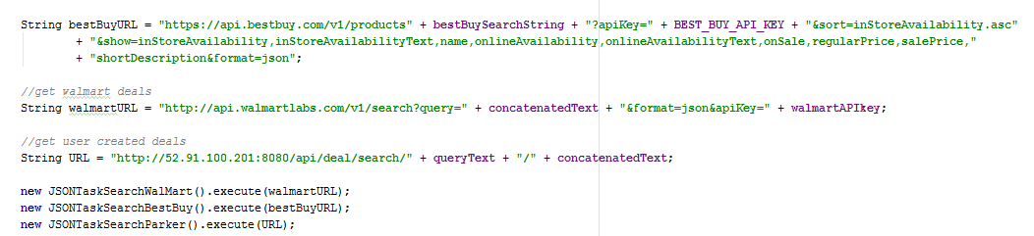
API Deals—Client Side Implementation
Best Buy and Walmart APIs used to search for online deals
Both require API Keys to identify the developer making the request (free for developers)
Both APIs are accessed using a GET request

Slide 16
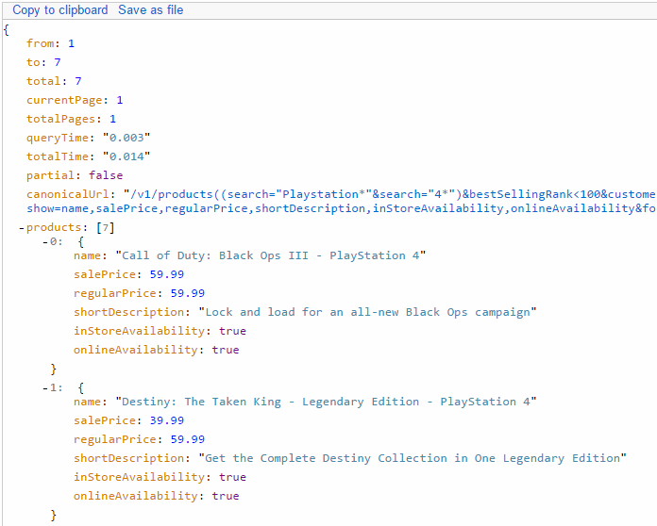
Best Buy Request/Response Example
GET request: https://api.bestbuy.com/v1/products((search=Playstation&search=4)&bestSellingRank<100&customerReviewCount>50)?apiKey=wmk4xz9c5ynrvcvcvwtzmp6r&sort=name.asc&show=name,salePrice,regularPrice,shortDescription,inStoreAvailability,onlineAvailability&format=json
Best Selling Rank and Customer Review Count were added in to filter poor results that are returned by default
A list of attributes we want back is also included
The request is denied without the API key
Partial response:

Slide 17
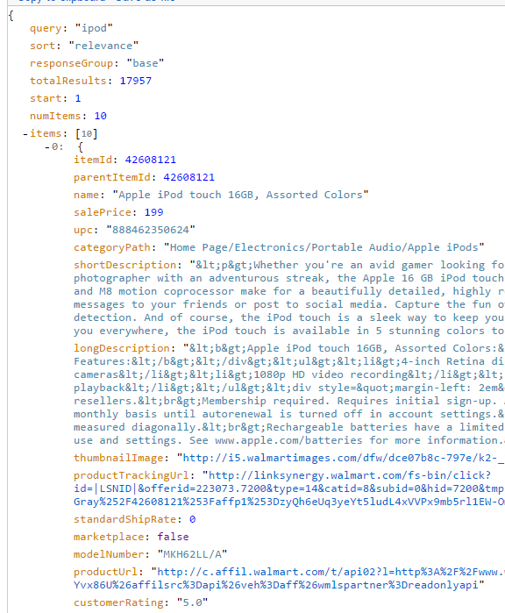
Walmart Request/Response Example
GET request: http://api.walmartlabs.com/v1/search?query=ipod&format=json&apiKey=e9rgk7ujvh43jaqxsytfcucm
The request is denied without the API key
Partial response:

Slide 18
Functional Requirement—User Deals
3. Users will be able to add an item that is available for sale to the system. (This allows users to add items that are not located by Requirement 2.)
4. Users will be able to validate whether an item is available at a sales price. (This allows users to determine whether an item is still available.)
5. Expired user-created deals will not appear in search results. (This feature is necessary for ensuring that only valid deals appear.)

Slide 19
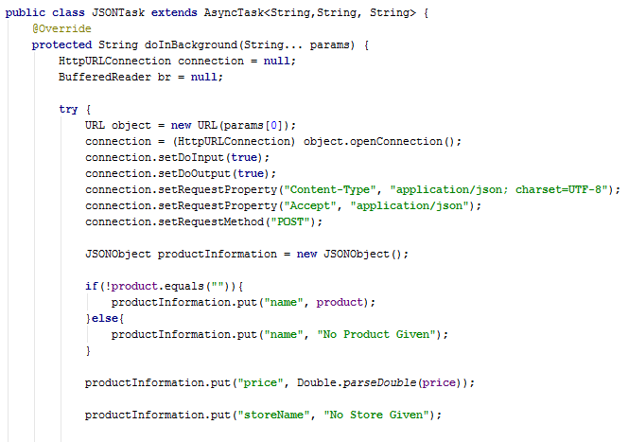
User Deals, Add—Client Side Implementation
Details of user deal are added into a JSON Object and posted to the database.
Error checking is done for various categories to prevent posting deals with no name, no expiration date, etc.

Slide 20
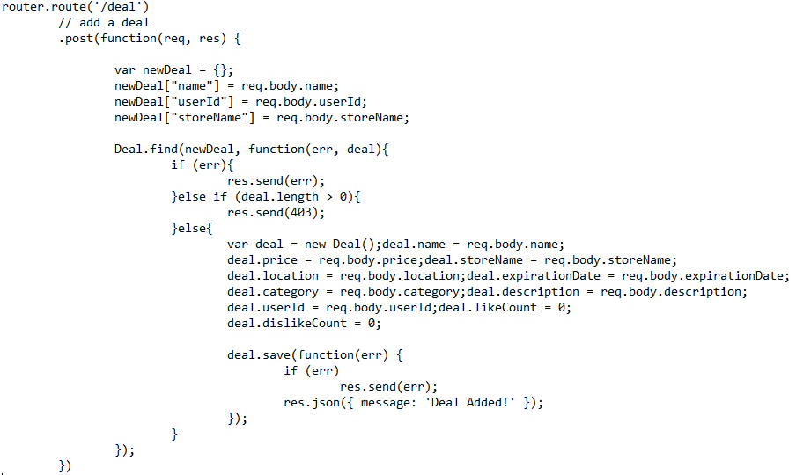
User Deals, Add—Server Side Implementation
Uses mongoose find method to determine whether a deal with same name, userid, and storename exists
Otherwise, the request is parsed and added to database using mongoose save method
Response is either error, 403 (forbidden), or success

Slide 21
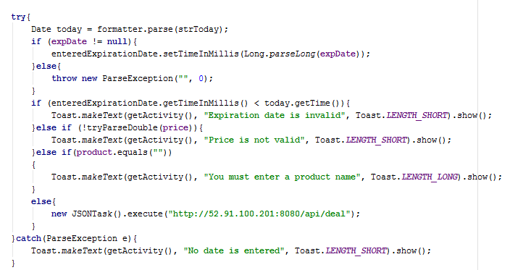
User Deals, Validate—Client Side Implementation
A check for product names, expiration dates, and prices is done before posting a deal to the database:

Slide 22
User Deals, Validate—Server Side Implementation
Since MongoDB does not support joining of tables (because there are no tables), this is implemented using count fields for like/dislike and an array of user ides for likes and dislikes.
Logic flow:
Check if user already likes/dislikes the deal by using the mongoose method count (searches the deal by id and checks if the user id is contained in their likes/dislikes array)
If the user already likes/dislikes the deal, then a conflict response is sent (409)
If the user is changing their vote, then the count fields and arrays are updated
If the user does not already like/dislike the deal, then the appropriate count field and array is updated
When the deal is liked/disliked, the deal is returned with an additional field indicating whether the vote has been changed

Slide 23
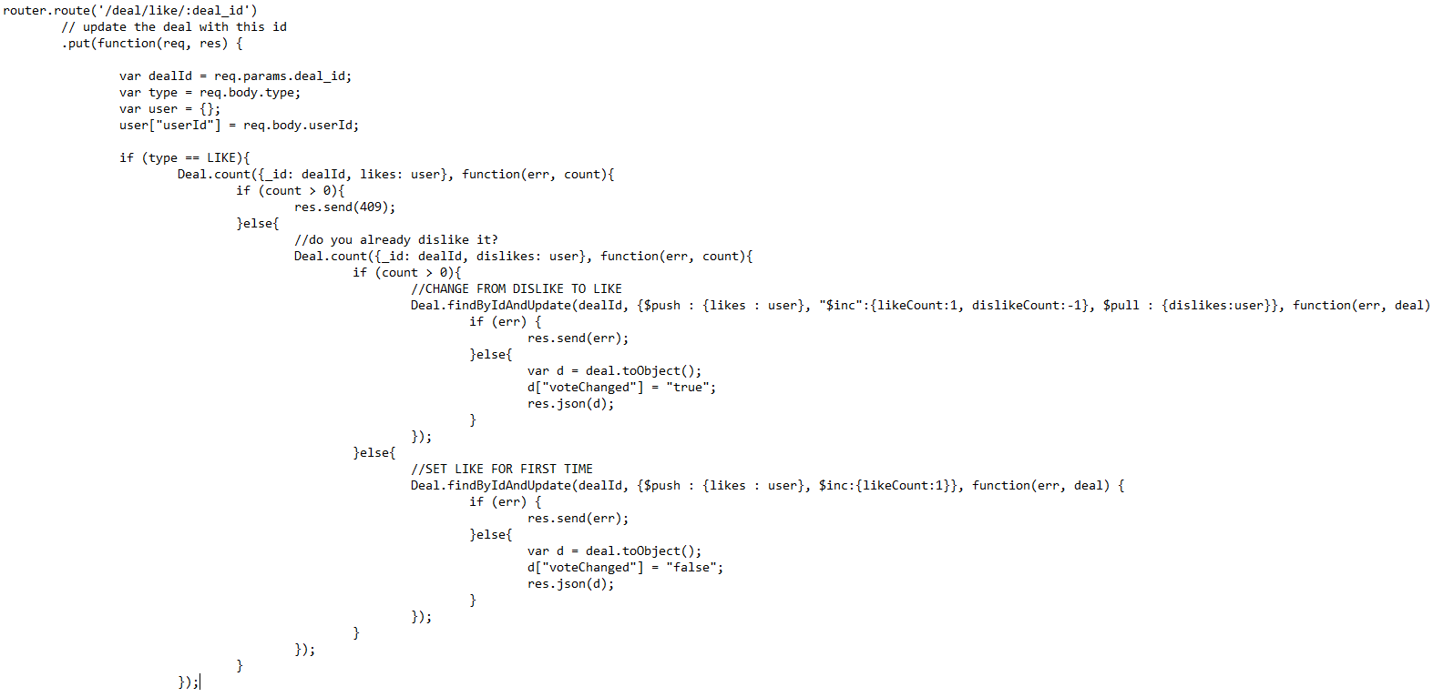
User Deals, Validate—Server Side Implementation

Slide 24
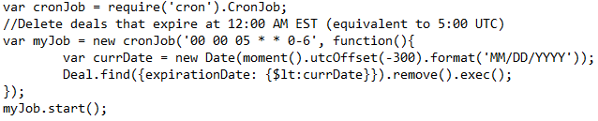
User Deals, Expire—Server Side Implementation
Uses cron module for scheduling regularly occurring jobs
Uses moment module for formatting date objects that are in UTC format
Currently expires dates at 12:00 AM EST
Uses mongoose find method that returns a query object. Then, uses the query object’s remove method

Slide 25
Functional Requirement--Database
6. User information and user-created deals will be stored in a database. (This is an essential feature ensuring that information is stored.)

Slide 26
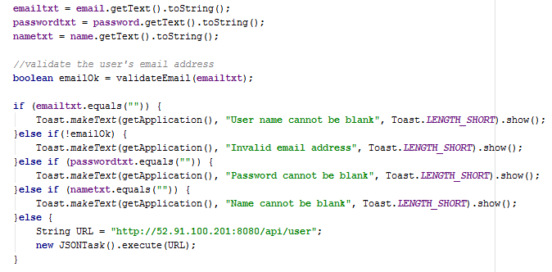
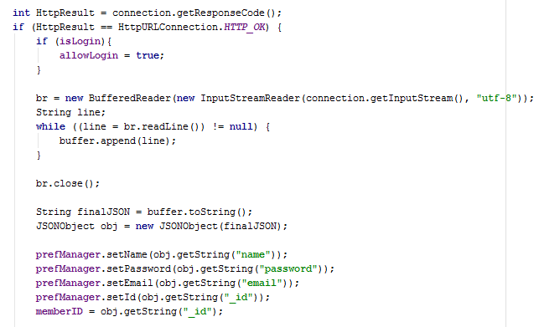

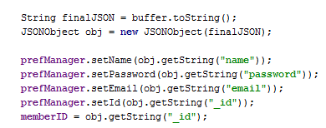
Database, User Information—Client Side Implementation
Checks made for input upon Registration:
Android’s built in email validator is used
to check email addresses:
Used is allowed to log in and preferences are set upon a successful Registration:

Slide 27
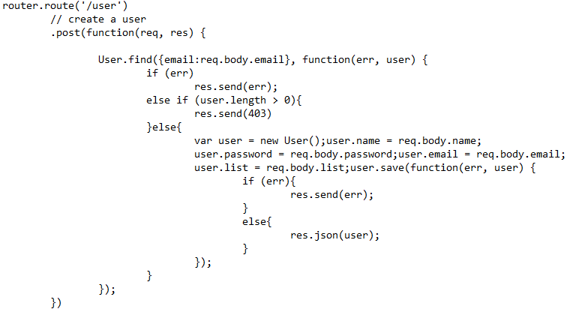
Database, User Information—Server Side Implementation
Adding a user, uses the mongoose find method to determine whether a user already exists with the same email as the request.
For an already existing user, http response 403 (forbidden) is returned
Otherwise, the req body is parsed and the new user is added to the database using the mongoose save method. The user as a JSON object is returned

Slide 28
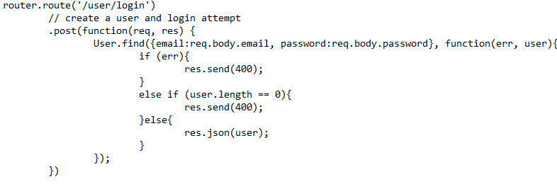
Database, User Information—Server Side Implementation
Since the user is uniquely named, logging in is handled using the mongoose find method with the parameters email and password
If the user is not found or there is an error, then http response 400 (bad request) is returned
Otherwise, the user as a JSON object is returned

Slide 29
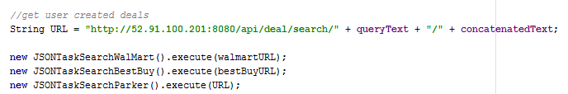
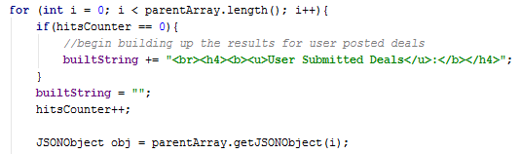
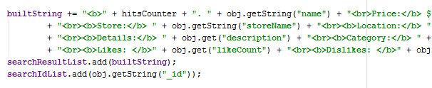
Database, User Deals—Client Side Implementation
User Deals are searched for be sending a request to the database
queryText is the category (Product Name or Store Name), concatenatedText is the product or store we are searching for, formatted as, Bed+Bath+and+Beyond
Requests return as a JSON array, and are parsed into individual products:

Slide 30
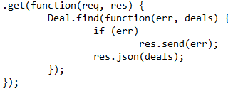
Database, User Deals—Server Side Implementation
Returning all of the user submitted deals is accomplished using the mongoose find method without any parameters
If there is an error than the error response is returned
Otherwise, the deals as JSON are returned

Slide 31
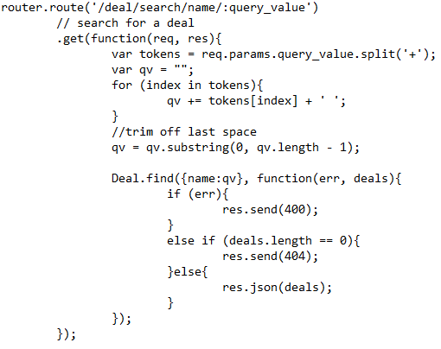
Database, User Deals—Server Side Implementation
User deals can be searched by name and store name. The search value is sent as part of the URL.
The search value will contain + symbols that require tokenizing
If there is an error than the error response is returned
If no deals are found, then 404 (not found) is returned
Otherwise, the deals as JSON are returned

Slide 32
Functional Requirement—User Information
7. Users shall be uniquely identified by a user name. (This prevents duplicate user names from existing in the system.)

Slide 33

User Information—Client Side Implementation
When Registering a new user, if the Node backend replies with HTTP_FORBIDDEN, that is our sign that this is a repeat email. This user is not permitted to register again.

Slide 34
User Information—Server Side Implementation
As seen previously, when attempting to add a user to the database, the mongoose find method is used to determine whether a user with the email already exists.

Slide 35
Additional Features
After a user registers, they have the option of logging in immediately
Login button is disabled preventing attempt at adding existing user information.
After a login, user information (name, email, password) is stored to Shared Preferences.
Login activity is bypassed when the user is logged in
Logout button available to logout (requiring a username and password to be entered)
Offline access is also available for last saved session to Shared Preferences
Capability of changing user’s password
Capability of deleting user

